Slide 1

Claude AI Excel Project Employee data

Slide 2

Data Cleaning

Slide 3
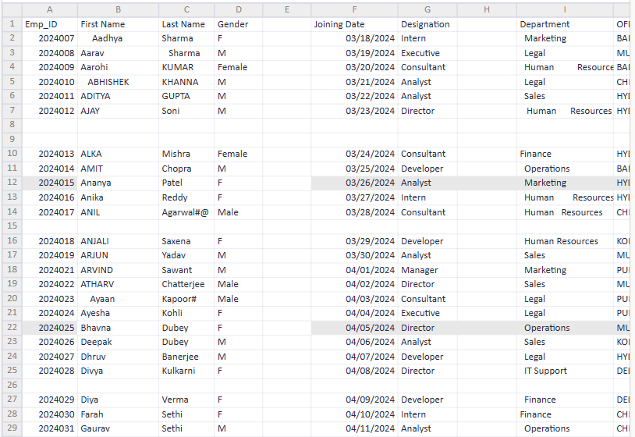
Prompt #1
Analyse this dataset and perform data cleaning process
I analyzed the raw employee dataset (966 rows, 11 columns) and found several data quality issues, then cleaned them into a new workbook with a documented log.
Issues found and fixed:
6 fully blank rows (spacer rows) — removed
2 empty helper columns (Unnamed: 4, Unnamed: 7) — dropped
Emp_ID stored as float due to blank rows — converted to integer
Names had stray symbols (e.g. Agarwal#@, Kapoor#) and inconsistent casing — cleaned and title-cased
Gender mixed F/M with Female/Male (953 abbreviated values) — standardized to full labels
Department had inconsistent spacing/line-wrapping (e.g. "Human Resources", " Marketing ") across 834 rows — trimmed and normalized
City was in ALL CAPS — converted to Title Case, column renamed OFFICE_CITY → City
Performance renamed to Performance Rating, converted to clean integers (1–5 scale, no out-of-range values)
Checked for duplicate Emp IDs post-clean: none found
Flagged but not altered (needs a human judgment call): 94 employees have a Joining Date after today (2026-09-18) — likely planned/future joiners rather than errors, worth confirming with HR.
The output file has two tabs: Cleaned Data (960 rows × 9 columns, formatted with headers, filters, and frozen panes) and Cleaning Summary (a step-by-step log plus review notes)

Slide 4
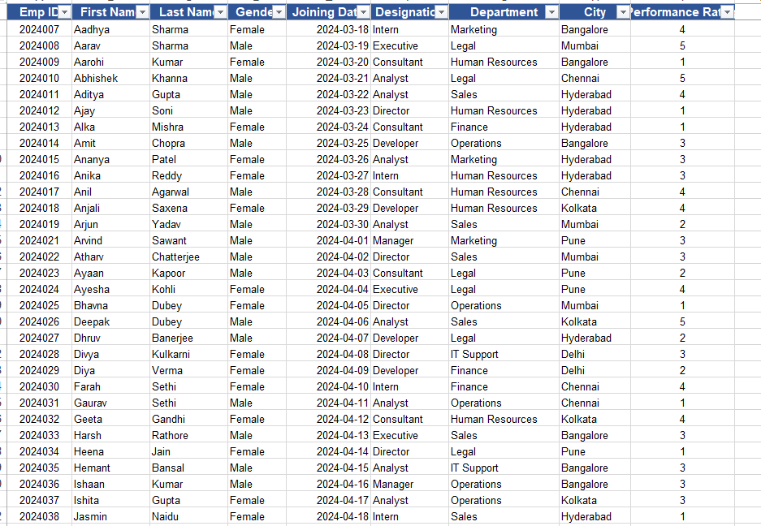
Cleaned Data set

Slide 5
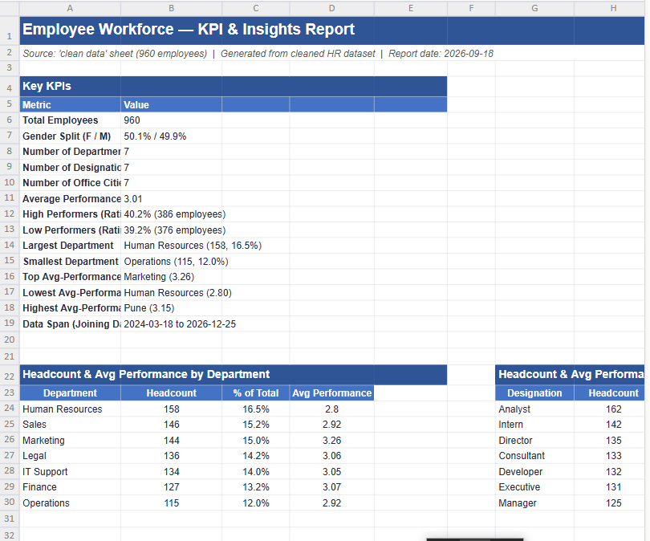
Prompt #2
Analyse this dataset and provide key KPIs, trends, insights, and suggested charts, and key points to improve/focus, generate report in New sheet and do not overlap reports
Key KPIs
960 employees, near-perfect gender balance (50.1% F / 49.9% M)
Avg performance rating: 3.01/5 — but the workforce is polarized: 40.2% high performers (4–5) vs. 39.2% low performers (1–2)
HR is largest dept (158, 16.5%) but lowest-performing (avg 2.80, 43.7% low performers)
Marketing is smallest-headcount standout: best avg performance (3.26), lowest low-performer rate (32.6%)
Steady hiring growth: 271 (2024) → 347 (2025) → 342 logged for 2026, ~29 hires/month
Trends & insights — performance-rating distribution, department/city/designation breakdowns, low-performer rates, and hiring trend are all laid out with supporting tables.
Suggested charts (also embedded live in the sheet) — headcount by department, avg performance by department, gender split (pie), performance-rating distribution, hiring trend by year, headcount by city.
Focus areas — 7 concrete recommendations, e.g., a performance-improvement push in HR, reviewing the Consultant designation, replicating Marketing's practices, and building a structured PIP pipeline given the large low-performer segment.

Slide 6
Dashboard Creation

Slide 7
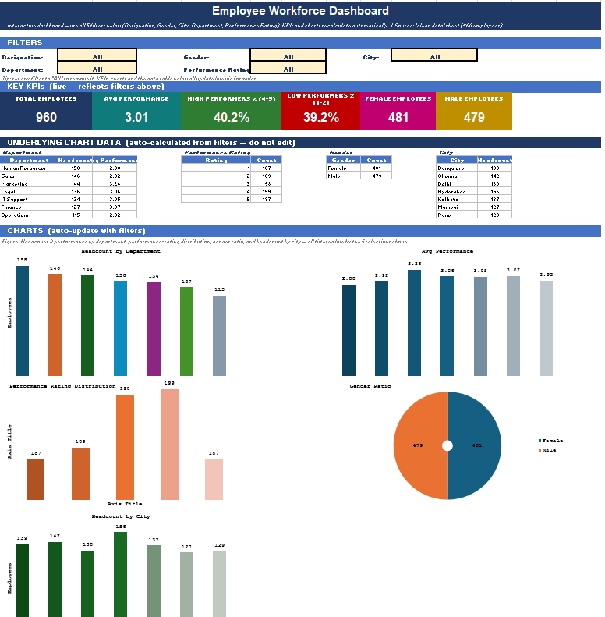
Prompt #3
Create Dashboard with heading Employee Workforce Dashboard create filter below the heading and refer sheet name KPI report and prepare charts KPI

